Slide 1
OS Marketing Updates January 2024

Slide 2
Social Media
Twitter Analytics
Instagram Analytics
Facebook Analytics
Newsletter Analytics – January 2024 Department Newsletter
MedBlog Analytics
News release
Broadcast Med
Google Review campaign

Slide 3
Twitter Month over Month
time | # of posts | impressions | engagements | engagement rate | avg. impressions | avg. engagement
February | 52 | 16583 | 643 | 3.90 | 319 | 12
March | 38 | 18218 | 751 | 4.12 | 479 | 20
April | 27 | 12683 | 375 | 3.00 | 470 | 14
May | 45 | 12915 | 379 | 2.90 | 287 | 8
June | 43 | 11872 | 564 | 4.80 | 276 | 13
July | 25 | 6900 | 186 | 2.7 | 276 | 7.44
August | 37 | 8276 | 302 | 3.60 | 224 | 8
September | 35 | 7063 | 197 | 2.80 | 202 | 6
October | 44 | 21385 | 463 | 2.20 | 486 | 11
November | 30 | 8521 | 280 | 3.30 | 284 | 9
December | 19 | 2929 | 107 | 3.70 | 154 | 6
January | 30 | 6026 | 171 | 2.80 | 201 | 6

Slide 4
Twitter Month over Month – Followers
 | Followers | Followers Gained
February | 837 | 22
March | 859 | 30
April | 882 | 26
May | 900 | 27
June | 910 | 20
July | 920 | 10
August | 935 | 24
September | 949 | 20
October | 964 | 19
November | 972 | 14
December | 978 | 11
January | 993 | 25
Data is from Sprout Social
Data Range is February 2023 to January 2024

Slide 5
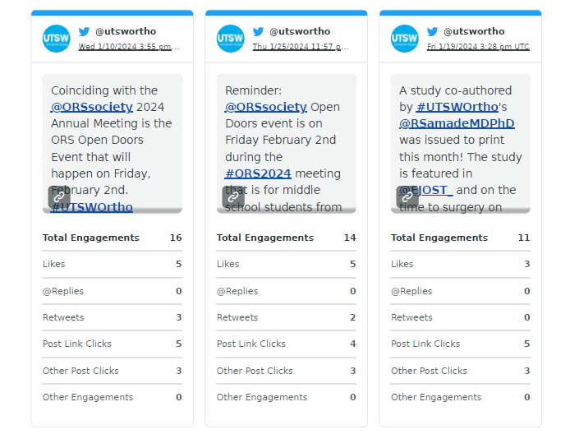
Twitter Month over Month – Top Posts
Data is from Sprout Social
Data is from January 2024

Slide 6
Instagram Month over Month
time | # of posts | impressions | engagements | engagement rate | average impressions | average engagement
February | 9 | 15184 | 213 | 1.4% | 1687 | 24
March | 8 | 27592 | 605 | 2.2% | 3449 | 76
April | 11 | 22763 | 260 | 1.1% | 2069 | 24
May | 16 | 18882 | 265 | 1.4% | 1180 | 17
June | 12 | 22442 | 445 | 2.0% | 1870 | 37
July | 20 | 14707 | 426 | 2.9% | 735 | 21
August | 23 | 14857 | 537 | 3.6% | 646 | 23
September | 36 | 16851 | 422 | 2.5% | 468 | 12
October | 40 | 18730 | 489 | 2.6% | 468 | 12
November | 17 | 9730 | 320 | 3.3% | 572 | 19
December | 13 | 6907 | 160 | 2.3% | 531 | 12
January | 12 | 8535 | 263 | 3.1% | 711 | 22

Slide 7
Instagram Month over Month – Stories
 | # of stories | Impressions | Story replies | Story tap backs | Story taps forward | Story exits
March | 12 | 4907 | 1 | 281 | 4190 | 813
April | 23 | 7264 | 4 | 361 | 5148 | 1430
May | 36 | 7444 | 10 | 278 | 5361 | 1437
June | 44 | 10825 | 13 | 590 | 8777 | 1377
July | 9 | 2116 | 4 | 67 | 1445 | 499
August | 11 | 2919 | 2 | 93 | 2121 | 517
September | 24 | 5510 | 7 | 312 | 4333 | 769
October | 28 | 5330 | 14 | 416 | 4767 | 1272
November | 8 | 1532 | 4 | 29 | 936 | 435
December | 9 | 1825 | 2 | 66 | 1294 | 368
January | 5 | 1618 | 4 | 43 | 961 | 405

Slide 8
Instagram Month over Month – Followers
 | Followers | Followers Gained
February | 1586 | 32
March | 1681 | 120
April | 1737 | 82
May | 1763 | 57
June | 1785 | 50
July | 1808 | 23
August | 1862 | 73
September | 1898 | 67
October | 1918 | 56
November | 1923 | 37
December | 1927 | 27
January | 1925 | 31
Data is from Sprout Social
Data Range is February 2023 – January 2024

Slide 9
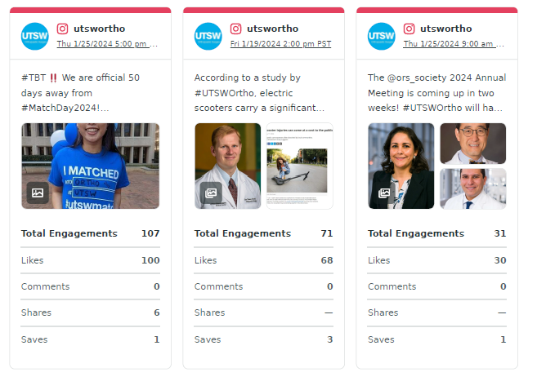
Instagram Month over Month – Top Posts
Data is from Sprout Social
Data is from January 2024

Slide 10
Facebook Month over Month
time | # of posts | impressions | engagements | engagement rate | avg. impressions | avg. engagement
February | 10 | 213 | 16 | 7.51 | 21 | 2
March | 25 | 1239 | 91 | 7.34 | 50 | 4
April | 28 | 1107 | 145 | 12.45 | 40 | 5
May | 32 | 952 | 69 | 7.2 | 30 | 2
June | 20 | 1442 | 182 | 12.6 | 72 | 9
July | 23 | 1102 | 74 | 6.7 | 48 | 3
August | 29 | 825 | 20 | 2.4 | 28 | 1
September | 27 | 1074 | 69 | 6.4 | 40 | 3
October | 22 | 801 | 43 | 5.4 | 36 | 2
November | 23 | 897 | 46 | 5.1 | 39 | 2
December | 14 | 915 | 41 | 4.5 | 65 | 3
January | 16 | 914 | 51 | 5.6 | 57 | 3

Slide 11
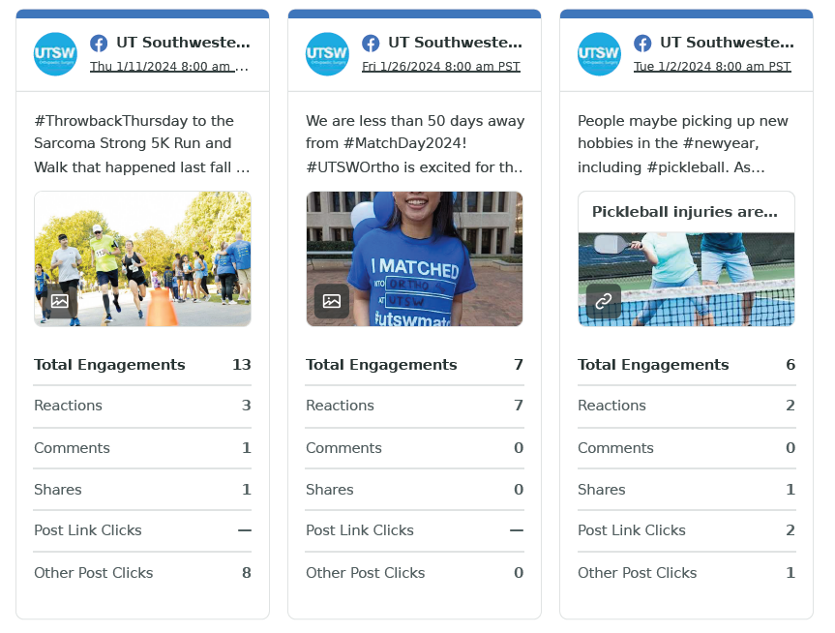
Facebook Month over Month – Top Posts
Data from Sprout Social
Data from January 2024

Slide 12
Monthly Newsletter – Constant Contact
time | sends | open rate | click rate | bounce rate | opens | clicks | unopen rate
February | 215 | 56 | 14 | 3 | 122 | 32 | 44
March | 222 | 56.9 | 15.3 | 2.7 | 123 | 33 | 43
April | 236 | 57 | 9 | 3.8 | 130 | 21 | 43
August | 234 | 60 | 11 | 5 | 135 | 24 | 40
September | 231 | 60 | 9 | 3 | 137 | 20 | 40
October | 233 | 54 | 9 | 3 | 122 | 21 | 46
Nov/Dec | 236 | 52 | 23 | 3 | 128 | 52 | 44
January | 232 | 53 | 19 | 1 | 121 | 43 | 47

Slide 13
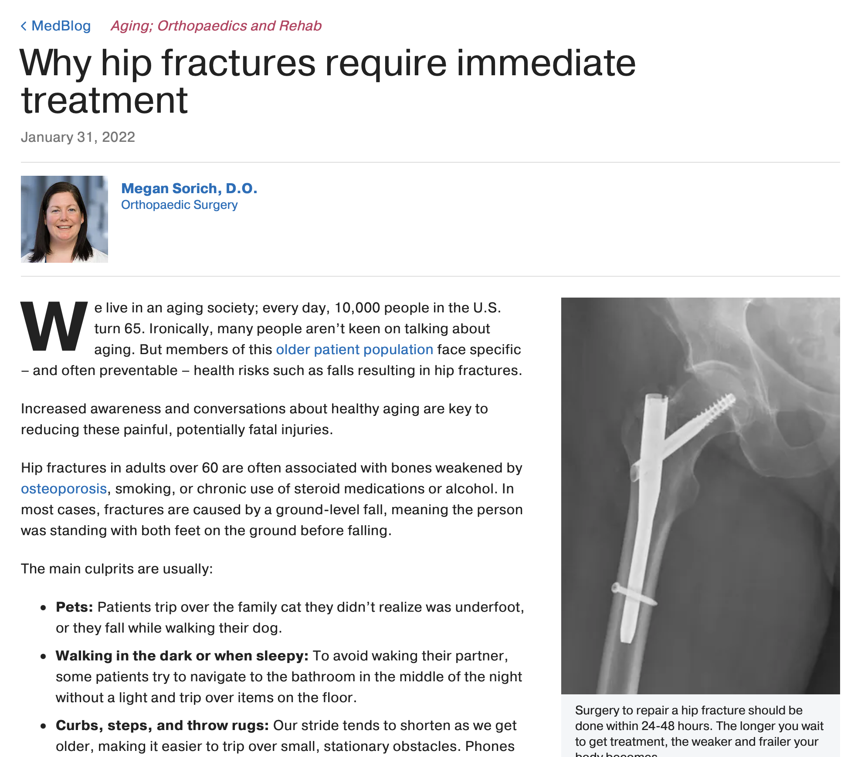
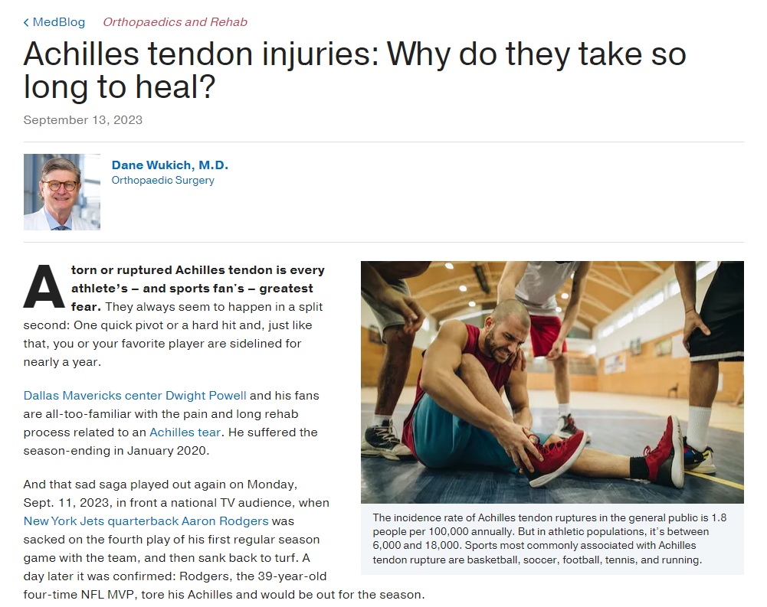
2024 MedBlog Report
Top Performing Blog (views in 2023)
Why Hip Fractures Require Immediate Attention
Dr. Sorich
Published January 2022
42,145 Pageviews
4:55 Time on Page
Top Performing Blog (views in past month)*
Achilles tendon injuries: Why do they take so long to heal?
Dr. Wukich
Republished September 13, 2023
1,236 Pageviews
6:44 Time on Page
There has been issues with getting monthly analytics., I will get the information situated in time for next month.

Slide 14
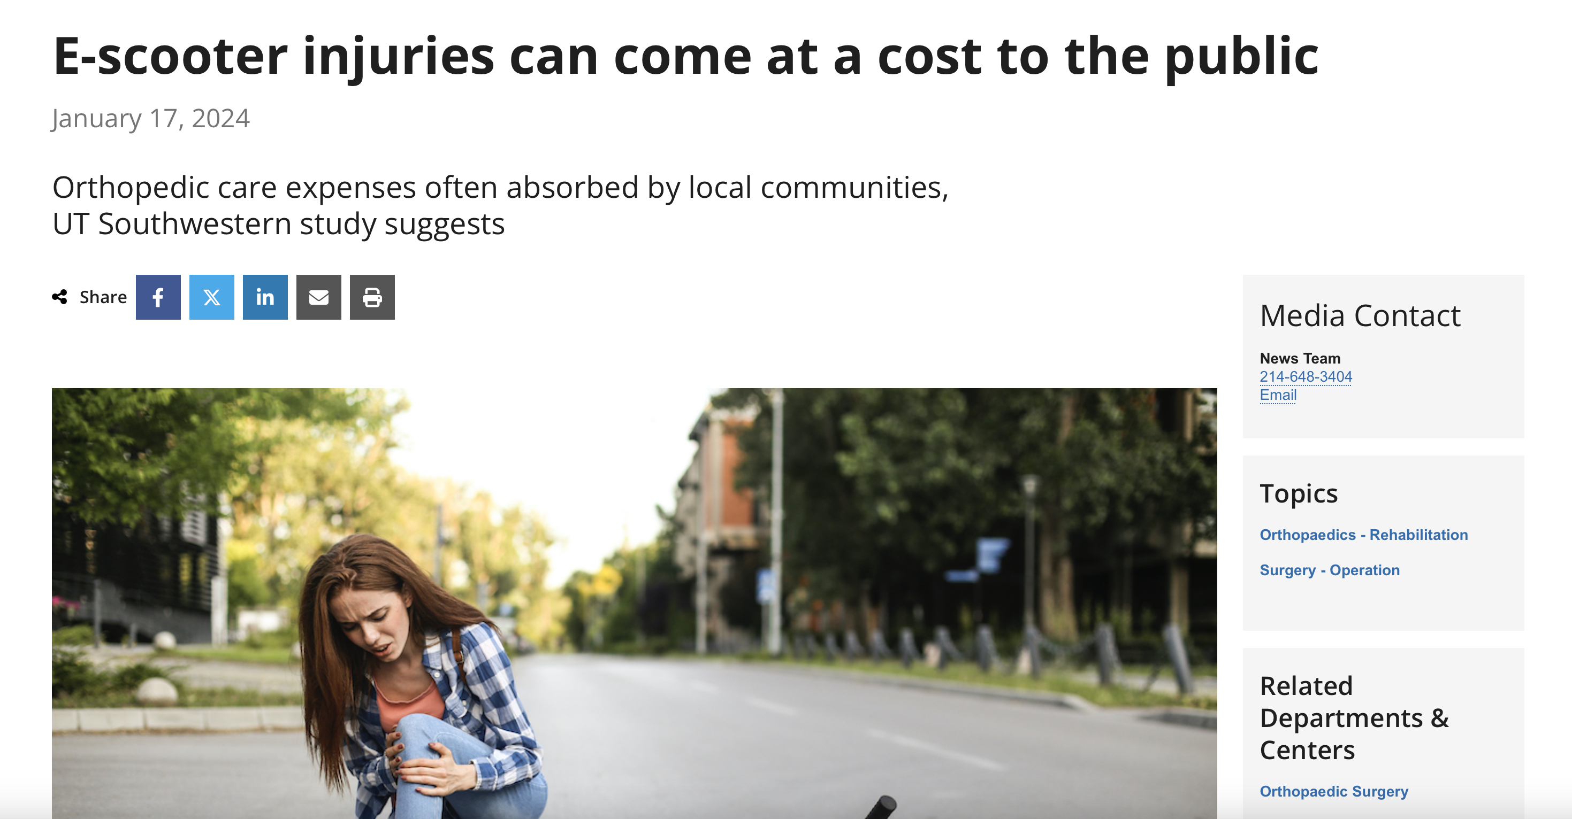
News Release
E-scooter study, Dr. Sanders

Slide 15
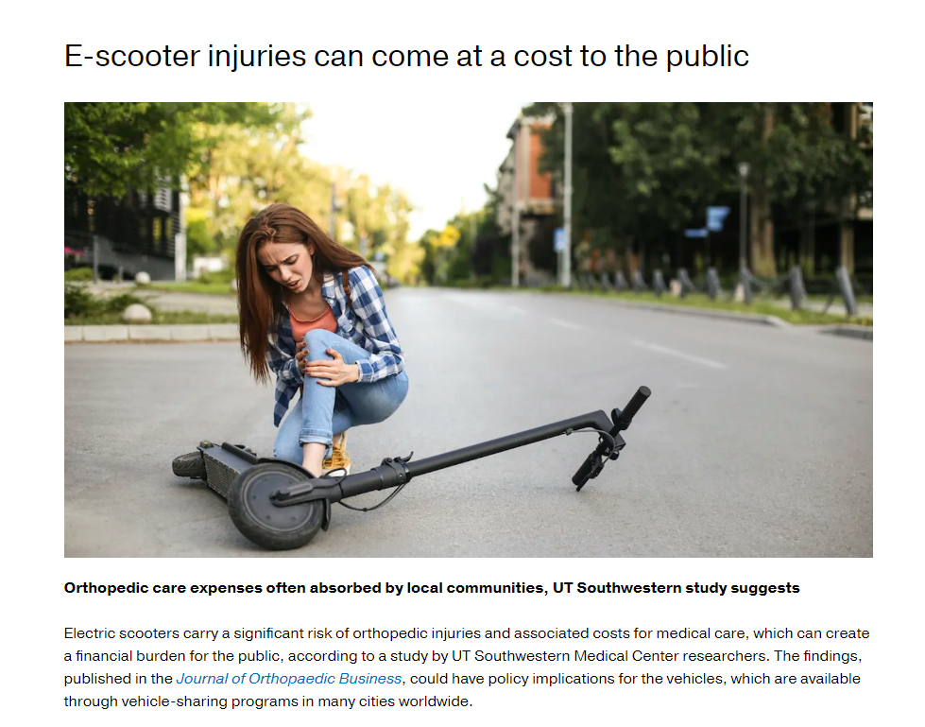
Physician Portal
- E-Scooter Dr. Sanders Study has been added

Slide 16
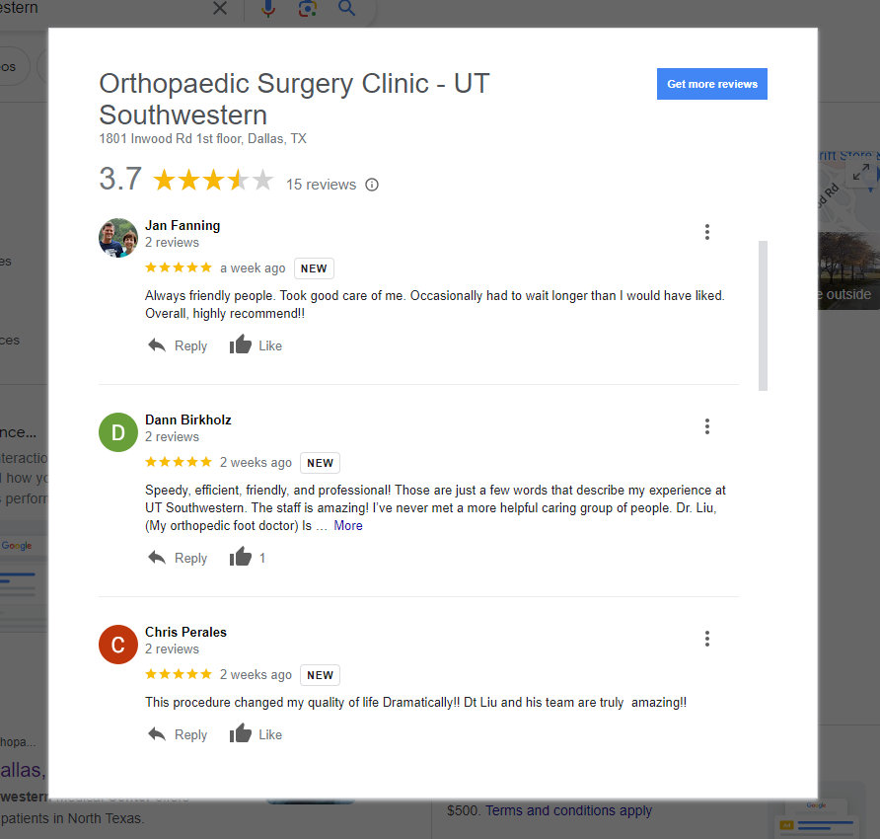
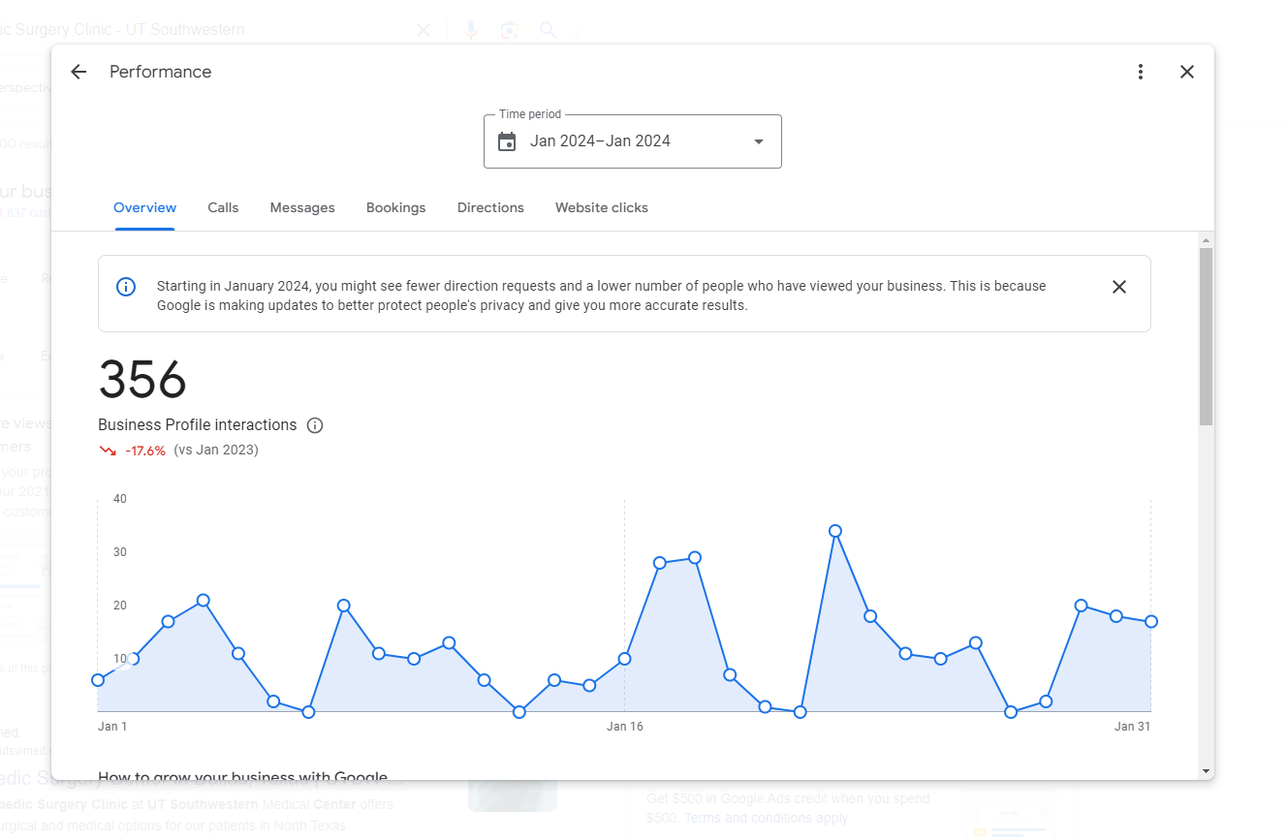
Google Review Campaign – January 2024
Notes:
Rating has gone up .4 the past month

